Slide 1
Tips for Deep Learning
Notes:
Add: vidualize learning

Slide 2

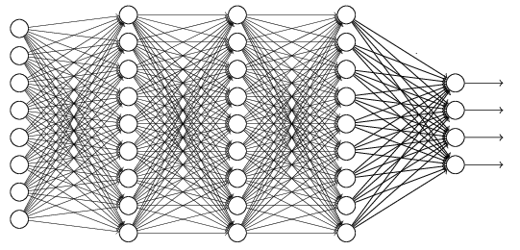
Recipe of Deep Learning
YES
Step 1: define a set of function
Step 2: goodness of function
Step 3: pick the best function
NO
Good Results on Testing Data?
Overfitting!
YES
NO
Good Results on Training Data?
Neural Network
Notes:
Other methods do not emphasize this.
Some machine learning methods do not emphasize this.

Slide 3
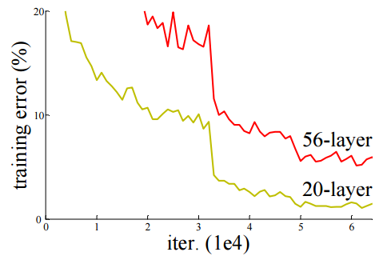
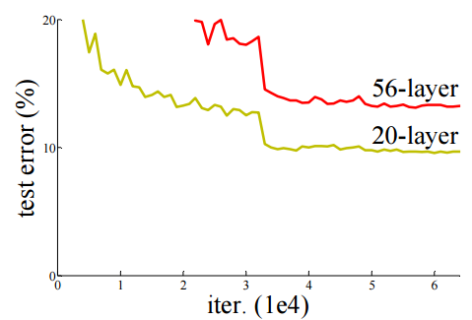

Do not always blame Overfitting
Not well trained
Overfitting?
Training Data
Testing Data
Deep Residual Learning for Image Recognition
http://arxiv.org/abs/1512.03385

Slide 4
Recipe of Deep Learning
YES
Good Results on Testing Data?
Different approaches for different problems.
YES
e.g. dropout for good results on testing data
Good Results on Training Data?
Neural Network
Notes:
加敏 加防

Slide 5
Part I: Poor Results on Training Data?
Notes:
Add: vidualize learning

Slide 6
Poor Results on Training Data?
Better Learning Rate Strategies?
Normalization
Activation Function
ReLU
SeLU
Larger Network?

Slide 7
Basic Concept
The functions defined by network structure
small
median
large
The functions with good results on training data.
Even though the network structure cover the good functions. Doesn’t mean you can find that.

Slide 8
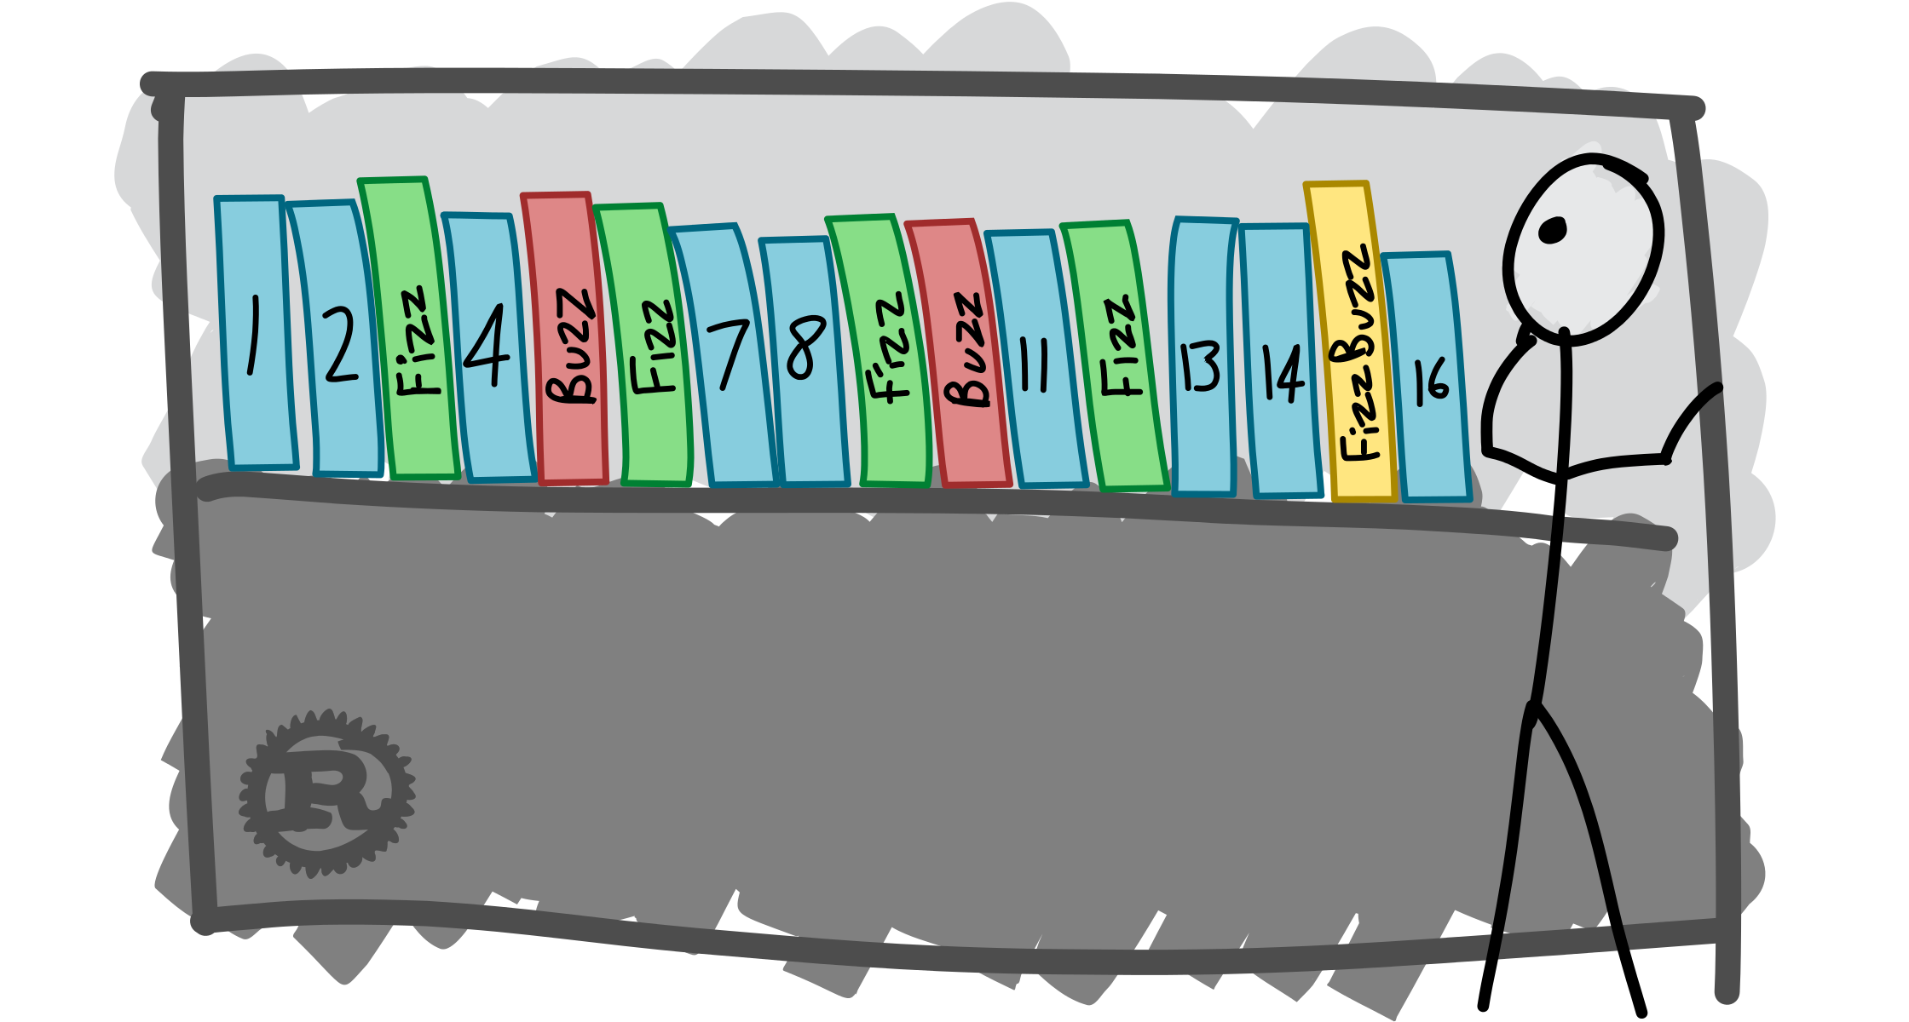
Fizz Buzz in Tensorflow

Slide 10
Poor Results on Training Data?
Better Learning Rate Strategies?
Normalization
Activation Function
ReLU
SeLU
Larger Network?

Slide 11
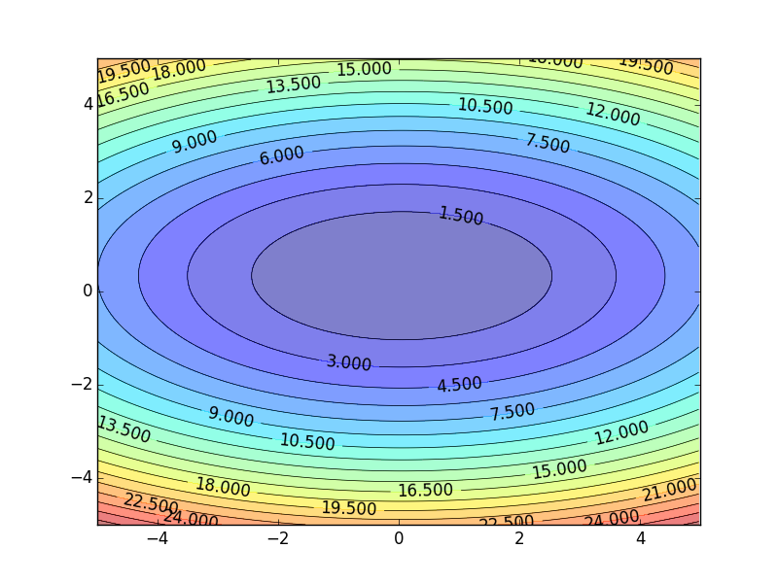
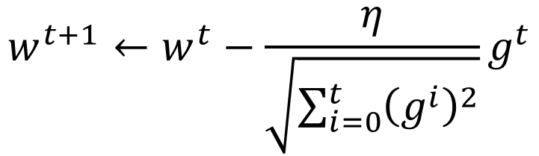


Review
Smaller Learning Rate
$$w_{2}$$
Larger Learning Rate
Adagrad
$$w_{1}$$
$$w^{t+1}←w^{t}−\frac{η}{\sqrt{\sum_{i=0}^{t}{{\left(g^{i}\right)}^{2}}}}g^{t}$$
Use first derivative to estimate second derivative
Notes:
Larger Gradient
Smaller Learning
Rate

Slide 12
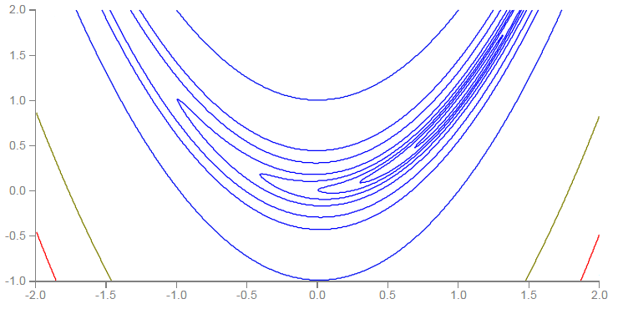


RMSProp
Error Surface can be very complex when training NN.
Smaller Learning Rate
$$w_{2}$$
Larger Learning Rate
$$w_{1}$$

Slide 13

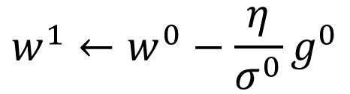

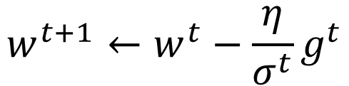

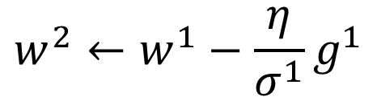


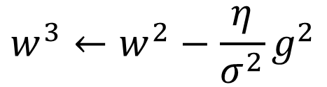
RMSProp
$$w^{1}←w^{0}−\frac{η}{σ^{0}}g^{0}$$
$$σ^{0}=g^{0}$$
$$w^{2}←w^{1}−\frac{η}{σ^{1}}g^{1}$$
$$σ^{1}=\sqrt{{α\left(σ^{0}\right)}^{2}+\left(1−α\right){\left(g^{1}\right)}^{2}}$$
$$w^{3}←w^{2}−\frac{η}{σ^{2}}g^{2}$$
$$σ^{2}=\sqrt{{α\left(σ^{1}\right)}^{2}+\left(1−α\right){\left(g^{2}\right)}^{2}}$$
$$……$$
$$w^{t+1}←w^{t}−\frac{η}{σ^{t}}g^{t}$$
$$σ^{t}=\sqrt{{α\left(σ^{t−1}\right)}^{2}+\left(1−α\right){\left(g^{t}\right)}^{2}}$$
Root Mean Square of the gradients with previous gradients being decayed
Notes:
Root Mean Squares of gradients

Slide 14



Hard to find optimal network parameters
Total
Loss
Very slow at the plateau
Stuck at saddle point
Stuck at local minima
$$∂L∕∂w$$
$$≈0$$
$$∂L∕∂w$$
$$=0$$
$$∂L∕∂w$$
$$=0$$
The value of a network parameter w

Slide 15
In physical world ……
Momentum
How about put this phenomenon in gradient descent?
Notes:
Momentum: 動量

Slide 16


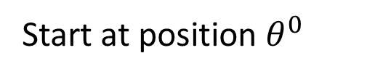
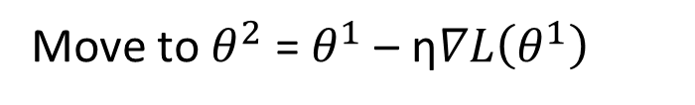

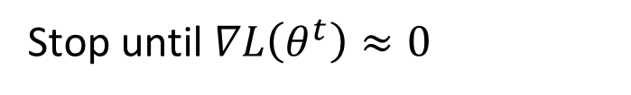
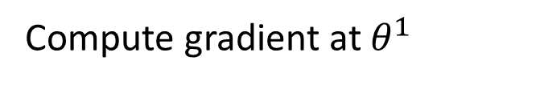

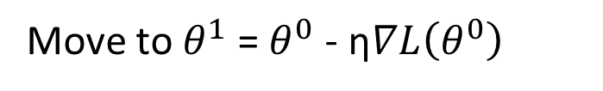


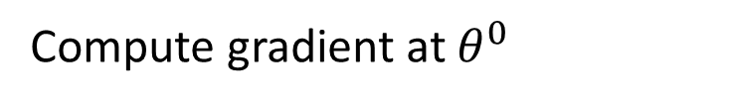


Review: Vanilla Gradient Descent
$$∇L\left(θ^{0}\right)$$
Start at position $θ^{0}$
$$∇L\left(θ^{1}\right)$$
Compute gradient at $θ^{0}$
$$θ^{0}$$
$$θ^{1}$$
Move to $θ^{1}$ = $θ^{0}$ - η$∇L\left(θ^{0}\right)$
$$∇L\left(θ^{2}\right)$$
Compute gradient at $θ^{1}$
$$θ^{2}$$
Gradient
Move to $θ^{2}$ = $θ^{1}$ – η$∇L\left(θ^{1}\right)$
Movement
$$∇L\left(θ^{3}\right)$$
$$θ^{3}$$
……
Stop until $∇L\left(θ^{t}\right)≈0$
Notes:
平凡的；普通的；乏味的

Slide 17
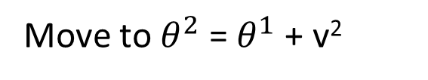

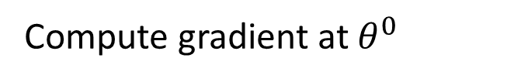
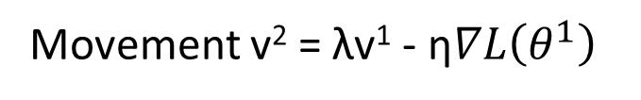

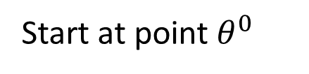

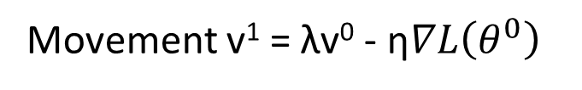

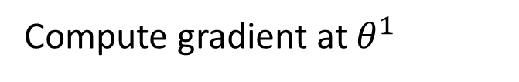


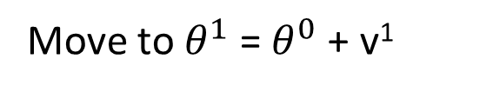


Momentum
Movement: movement of last step minus gradient at present
Start at point $θ^{0}$
Movement v⁰=0
$$∇L\left(θ^{0}\right)$$
Compute gradient at $θ^{0}$
$$∇L\left(θ^{1}\right)$$
$$θ^{0}$$
Movement v¹ = λv⁰ - η$∇L\left(θ^{0}\right)$
$$θ^{1}$$
Move to $θ^{1}$ = $θ^{0}$ + v¹
$$∇L\left(θ^{2}\right)$$
Compute gradient at $θ^{1}$
$$θ^{2}$$
Gradient
Movement v² = λv¹ - η$∇L\left(θ^{1}\right)$
Movement
Move to $θ^{2}$ = $θ^{1}$ + v²
$$θ^{3}$$
$$∇L\left(θ^{3}\right)$$
Movement not just based on gradient, but previous movement.
Movement
of last step

Slide 18
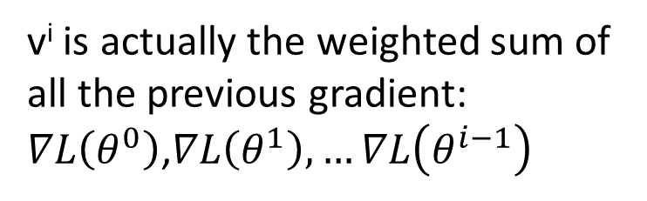
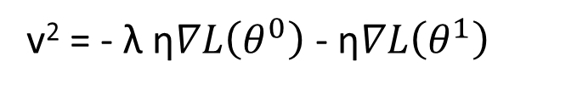
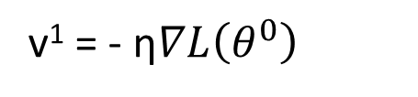
Momentum
Movement: movement of last step minus gradient at present
Start at point $θ^{0}$
Movement v⁰=0
Compute gradient at $θ^{0}$
v^{i} is actually the weighted sum of all the previous gradient: $∇L\left(θ^{0}\right)$,$∇L\left(θ^{1}\right), …∇L\left(θ^{i−1}\right)$
Movement v¹ = λv⁰ - η$∇L\left(θ^{0}\right)$
Move to $θ^{1}$ = $θ^{0}$ + v¹
v⁰ = 0
Compute gradient at $θ^{1}$
v¹ = - η$∇L\left(θ^{0}\right)$
Movement v² = λv¹ - η$∇L\left(θ^{1}\right)$
Move to $θ^{2}$ = $θ^{1}$ + v²
v² = - λ η$∇L\left(θ^{0}\right)$ - η$∇L\left(θ^{1}\right)$
Movement not just based on gradient, but previous movement
……
Notes:
Lambda = 0.9

Slide 19
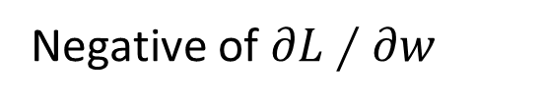
Momentum
Still not guarantee reaching global minima, but give some hope ……
cost
Movement =
Negative of 𝜕𝐿∕𝜕𝑤 + Momentum
Negative of $∂L∕∂w$
Momentum
Real Movement
𝜕𝐿∕𝜕𝑤 = 0
Notes:
What can we see?

Slide 20
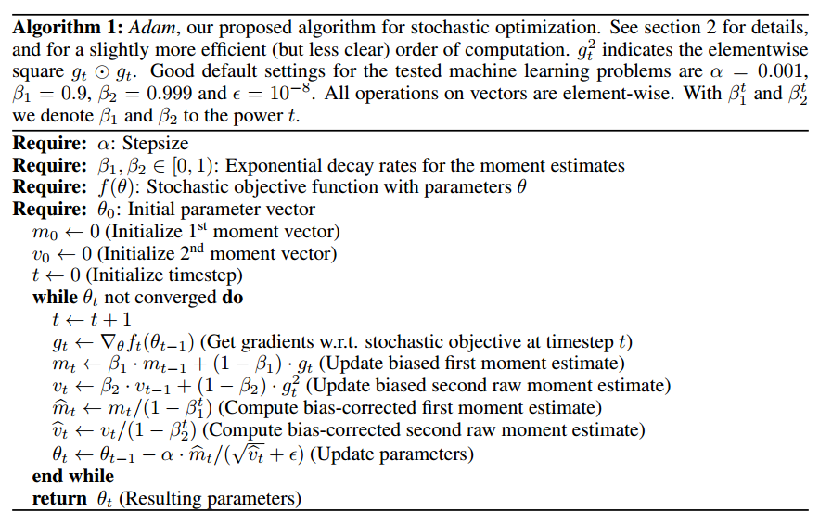
Adam
RMSProp + Momentum
for momentum
for RMSprop
Notes:
http://sebastianruder.com/optimizing-gradient-descent/
http://cs231n.github.io/neural-networks-3/
Original paper: https://arxiv.org/pdf/1412.6980.pdf

Slide 21
Poor Results on Training Data?
Better Learning Rate Strategies?
Normalization
Activation Function
ReLU
SeLU
Larger Network?

Slide 22
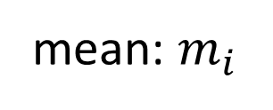







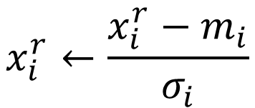

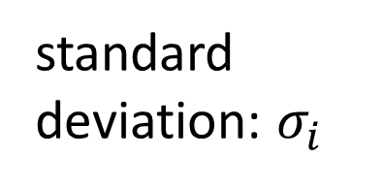

Feature Scaling
$$x^{1}$$
$$x^{2}$$
$$x^{3}$$
$$x^{r}$$
$$x^{R}$$
For each dimension i:
$$x_{1}^{1}$$
$$x_{1}^{2}$$
$$x_{2}^{1}$$
$$x_{2}^{2}$$
……
……
mean: $m_{i}$
……
……
……
……
……
standard deviation: $σ_{i}$
$$x_{i}^{r}←\frac{x_{i}^{r}−m_{i}}{σ_{i}}$$
The means of all dimensions are 0, and the variances are all 1
In general, gradient descent converges much faster with feature scaling than without it.
Notes:
Can we demo this???????????????
https://standardfrancis.wordpress.com/2015/04/16/batch-normalization/

Slide 23






How about Hidden Layer?
Feature Scaling
Feature Scaling ?
Feature Scaling ?
$$x^{1}$$
Layer 1
$$a^{1}$$
$$\text{Layer}\text{ 2}$$
$$a^{2}$$
……
Difficulty: their statistics change during the training …
Batch normalization
Smaller learning rate can be helpful, but the training would be slower.
Internal Covariate Shift
Notes:
Normalizes layer inputs to zero mean and unit variance. whitening.
Naive method: Train on a batch. Update model parameters. Then normalize. Doesn't work: Leads to exploding biases while distribution parameters (mean, variance) don't change.
If we do it this way gradient always ignores the effect that the normalization for the next batch would have
i.e. : “The issue with the above approach is that the gradient descent optimization does not take into account the fact that the normalization takes place”

Slide 24


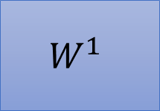




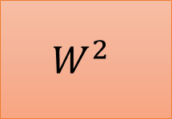














Batch
$$x^{1}$$
$$W^{1}$$
$$z^{1}$$
Sigmoid
$$a^{1}$$
$$W^{2}$$
……
$$x^{2}$$
$$W^{1}$$
$$z^{2}$$
Sigmoid
$$a^{2}$$
$$W^{2}$$
……
$$x^{3}$$
$$W^{1}$$
$$z^{3}$$
Sigmoid
$$a^{3}$$
$$W^{2}$$
……
$$z^{1}$$
$$z^{2}$$
$$z^{3}$$
$$W^{1}$$
$$x^{1}$$
$$x^{2}$$
$$x^{3}$$
Batch
=
Notes:
上學期好多人做!
https://ntumlds.wordpress.com/2017/03/26/r05922005_rrrr/

Slide 25


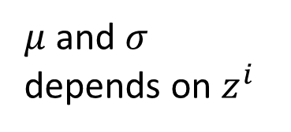

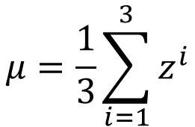
Batch normalization
$$μ=\frac{1}{3}\sum_{i=1}^{3}{z^{i}}$$
$$x^{1}$$
$$W^{1}$$
$$z^{1}$$
$$σ=\sqrt{\frac{1}{3}\sum_{i=1}^{3}{{\left(z^{i}−μ\right)}^{2}}}$$
$$x^{2}$$
$$W^{1}$$
$$z^{2}$$
Note: Batch normalization cannot be applied on small batch.
$$x^{3}$$
$$W^{1}$$
$$z^{3}$$
$μ$ and $σ$ depends on $z^{i}$
$$μ$$
$$σ$$
Notes:
上學期好多人做!
https://ntumlds.wordpress.com/2017/03/26/r05922005_rrrr/

Slide 26



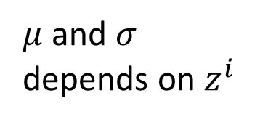




Batch normalization
$${\tilde{z}}^{i}=\frac{z^{i}−μ}{σ}$$
$$x^{1}$$
$$W^{1}$$
$$z^{1}$$
$${\tilde{z}}^{1}$$
Sigmoid
$$a^{1}$$
$$x^{2}$$
$$W^{1}$$
$$z^{2}$$
$${\tilde{z}}^{2}$$
Sigmoid
$$a^{2}$$
$$x^{3}$$
$$W^{1}$$
$$z^{3}$$
$${\tilde{z}}^{3}$$
Sigmoid
$$a^{3}$$
$$μ$$
$$σ$$
How to do backpropogation?
$μ$ and $σ$ depends on $z^{i}$
Notes:
上學期好多人做!
https://ntumlds.wordpress.com/2017/03/26/r05922005_rrrr/

Slide 27







Batch normalization
$${\tilde{z}}^{i}=\frac{z^{i}−μ}{σ}$$
$${\hat{z}}^{i}=γ⨀{\tilde{z}}^{i}+β$$
$$x^{1}$$
$$W^{1}$$
$$z^{1}$$
$${\tilde{z}}^{1}$$
$${\hat{z}}^{1}$$
$$x^{2}$$
$$W^{1}$$
$$z^{2}$$
$${\tilde{z}}^{2}$$
$${\hat{z}}^{2}$$
$$x^{3}$$
$$W^{1}$$
$$z^{3}$$
$${\tilde{z}}^{3}$$
$${\hat{z}}^{3}$$
$$μ$$
$$σ$$
$$β$$
$$γ$$
$μ$ and $σ$ depends on $z^{i}$
Notes:
上學期好多人做!
https://ntumlds.wordpress.com/2017/03/26/r05922005_rrrr/

Slide 28






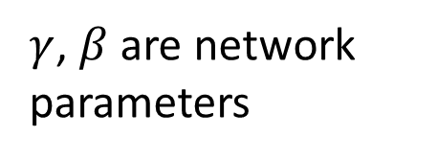






Batch normalization
Acc
$$μ_{300}$$
$$μ_{100}$$
$$μ_{1}$$
At testing stage:
Updates
$$\tilde{z}=\frac{z−μ}{σ}$$
$$\tilde{z}$$
$${\hat{z}}^{i}=γ⨀{\tilde{z}}^{i}+β$$
$$\hat{z}$$
$$x$$
$$W^{1}$$
$$z$$
$μ$, $σ$ are from batch
$γ$, $β$ are network parameters
We do not have batch at testing stage.
Ideal solution:
Computing $μ$ and $σ$ using the whole training dataset.
Practical solution:
Computing the moving average of $μ$ and $σ$ of the batches during training.
Notes:
上學期好多人做!
https://ntumlds.wordpress.com/2017/03/26/r05922005_rrrr/

Slide 29













Batch normalization - Benefit
BN reduces training times, and make very deep net trainable.
Because of less Covariate Shift, we can use larger learning rates.
Less exploding/vanishing gradients
Especially effective for sigmoid, tanh, etc.
Learning is less affected by initialization.
BN reduces the demand for regularization.
$$×k$$
$$×k$$
$$keep$$
$$x^{i}$$
$$W^{1}$$
$$z^{i}$$
$${\tilde{z}}^{i}$$
$${\hat{z}}^{i}$$
$$k$$
$$k$$
$${\tilde{z}}^{i}=\frac{z^{i}−μ}{σ}$$
$${\hat{z}}^{i}=γ⨀{\tilde{z}}^{i}+β$$
$$k$$
Notes:
Because the means and variances are calculated over batches and therefore every normalized value depends on the current batch. I.e. the network can no longer just memorize values and their correct answers.)

Slide 31
Demo

Slide 32
Poor Results on Training Data?
Better Learning Rate Strategies?
Normalization
Activation Function
ReLU
SeLU
Larger Network?

Slide 33
Vanishing Gradient Problem
……
y₁
……
y₂
……
……
……
……
……
……
y_{M}
Smaller gradients
Larger gradients
Learn very slow
Learn very fast
Almost random
Already converge
based on random!?
Notes:
The problem of gradient vanish is very hard to explain ……………….!!!!!!!!!!!!!!!!!!!!!!!!!!!!!!!!!
石頭湯裡的石頭
See Gradient flow in recurrent nets: the difficulty of learning long-term dependencies, by Sepp Hochreiter, Yoshua Bengio, Paolo Frasconi, and Jürgen Schmidhuber (2001). This paper studied recurrent neural nets, but the essential phenomenon is the same as in the feedforward networks we are studying. See also Sepp Hochreiter's earlier Diploma Thesis,Untersuchungen zu dynamischen neuronalen Netzen (1991, in German).
Stuck at a bad local minima
When deep learning is difficult in early year
Need initialization
Another point of view
Definition of gradient

Slide 34
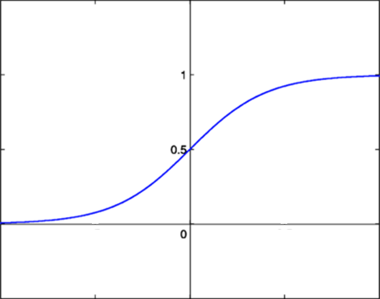




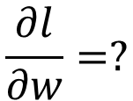






Vanishing Gradient Problem
Smaller gradients
……
$$y_{1}$$
$${\hat{y}}_{1}$$
Small output
……
$$y_{2}$$
$${\hat{y}}_{2}$$
……
……
……
……
……
$$l$$
……
$$+∆l$$
……
$$y_{M}$$
$${\hat{y}}_{M}$$
Large input
$$+∆w$$
Intuitive way to compute the derivatives …
$$\frac{∂l}{∂w}=?$$
$$\frac{∆l}{∆w}$$

Slide 35
Poor Results on Training Data?
Better Learning Rate Strategies?
Normalization
Activation Function
ReLU
SeLU
Larger Network?

Slide 36





ReLU
Rectified Linear Unit (ReLU)
Reason:
$$a$$
$$σ\left(z\right)$$
1. Fast to compute
$$a=z$$
2. Biological reason
$$a=0$$
3. Infinite sigmoid with different biases
$$z$$
4. Vanishing gradient problem
[Xavier Glorot, AISTATS’11]
[Andrew L. Maas, ICML’13]
[Kaiming He, arXiv’15]
Notes:
Parametric ReLU, -> PReLU
Ref: Glorot, Xavier, Antoine Bordes, and Yoshua Bengio. "Deep sparse rectifier neural networks." International Conference on Artificial Intelligence and Statistics. 2011.
No differentailalbe how about 0
Benefit:
2011
Where does it come from?
fast to compute
biology?
many sigmoid

Slide 37
ReLU
$$a$$
$$a=z$$
$$a=0$$
$$z$$
0
0
0
0

Slide 38
ReLU
$$a$$
$$a=z$$
A Thinner linear network
$$a=0$$
$$z$$
Do not have smaller gradients

Slide 39




ReLU - variant
$$Leaky ReLU$$
$$Parametric ReLU$$
$$a$$
$$a$$
$$a=z$$
$$a=z$$
$$z$$
$$z$$
$$a=0.01z$$
$$a=αz$$
α also learned by gradient descent

Slide 40












Maxout
ReLU is a special cases of Maxout
Learnable activation function [Ian J. Goodfellow, ICML’13]
+
neuron
+
$$5$$
$$1$$
Input
Max
$$7$$
Max
$$2$$
+
$$7$$
+
$$2$$
+
$$−1$$
+
$$4$$
Max
$$1$$
Max
$$4$$
+
$$1$$
+
$$3$$
You can have more than 2 elements in a group.
Notes:
How to train? Latter
2013
Ian J. Goodfellow goodfeli@iro.umontreal.ca David Warde-Farley wardefar@iro.umontreal.ca Mehdi Mirza mirzamom@iro.umontreal.ca Aaron Courville aaron.courville@umontreal.ca Yoshua Bengio

Slide 41











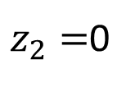







Maxout
ReLU is a special cases of Maxout
+
$$z_{1}^{}$$
$$z$$
ReLU
Input
$$w$$
$$a$$
Input
$$w$$
Max
$$b$$
$$a$$
$$0$$
+
$$z_{2}^{}$$
$$max\left\{z_{1}^{},z_{2}^{}\right\}$$
$$b$$
$$0$$
$$a$$
$$a$$
$$z=wx+b$$
$$z_{1}=wx+b$$
$$x$$
$$x$$
$z_{2}=$0

Slide 42



Maxout
More than ReLU
+
$$z_{1}^{}$$
$$z$$
ReLU
Input
$$w$$
$$a$$
Input
$$w$$
Max
$$b$$
$$a$$
+
$$z_{2}^{}$$
$$w^{′}$$
$$max\left\{z_{1}^{},z_{2}^{}\right\}$$
$$b$$
$$b^{′}$$
Learnable Activation Function
$$a$$
$$a$$
$$z=wx+b$$
$$z_{1}=wx+b$$
$$x$$
$$x$$
$$z_{2}=w^{′}x+b^{′}$$

Slide 43
Maxout
Learnable activation function [Ian J. Goodfellow, ICML’13]
Activation function in maxout network can be any piecewise linear convex function
How many pieces depending on how many elements in a group
2 elements in a group
3 elements in a group
Notes:
3,4,5

Slide 44
















Maxout - Training
Given a training data x, we know which z would be the max
+
$$z_{1}^{1}$$
+
$$z_{1}^{2}$$
Input
Max
$$a_{1}^{1}$$
Max
$$a_{1}^{2}$$
+
$$z_{2}^{1}$$
+
$$z_{2}^{2}$$
$$max\left\{z_{1}^{1},z_{2}^{1}\right\}$$
+
$$z_{3}^{1}$$
+
$$z_{3}^{2}$$
Max
$$a_{2}^{1}$$
Max
$$a_{2}^{2}$$
$$x$$
+
$$z_{4}^{1}$$
$$a^{1}$$
+
$$z_{4}^{2}$$
$$a^{2}$$

Slide 45
Maxout - Training
Given a training data x, we know which z would be the max
Train this thin and linear network
+
$$z_{1}^{1}$$
+
$$z_{1}^{2}$$
Input
$$a_{1}^{1}$$
$$a_{1}^{2}$$
+
$$z_{2}^{1}$$
+
$$z_{2}^{2}$$
+
$$z_{3}^{1}$$
+
$$z_{3}^{2}$$
$$x$$
$$a_{2}^{1}$$
$$a_{2}^{2}$$
+
$$z_{4}^{1}$$
$$a^{1}$$
+
$$z_{4}^{2}$$
$$a^{2}$$
Different thin and linear network for different examples

Slide 46
Poor Results on Training Data?
Better Learning Rate Strategies?
Normalization
Activation Function
ReLU
SeLU
Larger Network?

Slide 47






ReLU - variant
https://github.com/bioinf-jku/SNNs
Exponential Linear Unit (ELU)
Scaled ELU (SELU)
$$a$$
$$a$$
$$a=z$$
$$a=z$$
$$×λ$$
$$z$$
$$z$$
$$×λ$$
$$a=α\left(e^{z}−1\right)$$
$$a=α\left(e^{z}−1\right)$$
$$α=1.6732632423543772848170429916717$$
$$λ=1.0507009873554804934193349852946$$

Slide 48





SELU
$$α=1.673263242…$$
$$λ=1.050700987…$$
$$a=λz$$
$$a=λα\left(e^{z}−1\right)$$
Positive and negative values
The whole ReLU family has this property except the original ReLU.
Saturation region
ELU also has this property
Slope larger than 1
Only SELU also has this property

Slide 49







SELU
$$μ_{z}=E\left[z\right]$$
$$=\sum_{k=1}^{K}{E\left[a_{k}\right]}w_{k}$$
$$=μ\sum_{k=1}^{K}{w_{k}}$$
$$=μ∙{Kμ}_{w}$$
$$μ$$
=0
=0
The inputs are i.i.d random variables with mean $μ$ and variance $σ^{2}$.
=0
=1
…
…
…
…
Do not have to be Gaussian
Notes:
The intuition here is that high variance in one layer is mapped to low variance in the next layer and vice versa. This works because the SELU decreases the variance for negative inputs and increases the variance for positive inputs. The decrease effect is stronger for very negative inputs, and the increase effect is stronger for near-zero values.
Theorem 2 — the mapping of variance is bounded from above so gradients cannot explode
Theorem 3—the mapping of variance is bounded from below so gradients cannot vanish

Slide 50
















SELU
$$μ_{z}=0$$
$$μ_{w}=0$$
$$σ_{z}^{2}=E\left[{\left(z−μ_{z}\right)}^{2}\right]$$
$$=E\left[z^{2}\right]$$
$$=E\left[{\left(a_{1}w_{1}+a_{2}w_{2}+⋯\right)}^{2}\right]$$
The inputs are i.i.d random variables with mean $μ$ and variance $σ^{2}$.
$$=\sum_{k=1}^{K}{{\left(w_{k}\right)}^{2}σ^{2}}$$
$$=σ^{2}∙{Kσ}_{w}^{2}$$
$$=1$$
=0
=1
=1
=1
$$E\left[{\left(a_{k}w_{k}\right)}^{2}\right]$$
$$={\left(w_{k}\right)}^{2}E\left[{\left(a_{k}\right)}^{2}\right]$$
$$={\left(w_{k}\right)}^{2}σ^{2}$$
$$E\left[a_{i}a_{j}w_{i}w_{j}\right]$$
$$=w_{i}w_{j}E\left[a_{i}\right]E\left[a_{j}\right]$$
$$=0$$
…
…
…
target
…
Assume Gaussian
$$μ=0,σ=1$$
Notes:
The intuition here is that high variance in one layer is mapped to low variance in the next layer and vice versa. This works because the SELU decreases the variance for negative inputs and increases the variance for positive inputs. The decrease effect is stronger for very negative inputs, and the increase effect is stronger for near-zero values.
Theorem 2 — the mapping of variance is bounded from above so gradients cannot explode
Theorem 3—the mapping of variance is bounded from below so gradients cannot vanish

Slide 51
Demo
Notes:
http://140.112.21.35:6001/tree?token=f75a8b24c45107363a1a26cc9ad2736bbe4e373ade6b24a7
http://140.112.21.35:6001/notebooks/SELU.ipynb

Slide 52

93 頁的證明
Source of joke: https://zhuanlan.zhihu.com/p/27336839
SELU is actually more general.

Slide 53

MNIST
CIFAR-10
最新激活神經元:SELF-NORMALIZATION NEURAL NETWORK (SELU)
Notes:
GELU:

Slide 54
Demo
Notes:
http://140.112.21.35:6001/tree?token=f75a8b24c45107363a1a26cc9ad2736bbe4e373ade6b24a7
http://140.112.21.35:6001/notebooks/SELU.ipynb

Slide 55
Part II: Poor Results on Testing Data?
Notes:
Add: vidualize learning

Slide 56
Poor Results on Testing Data?
More Data?
Early Stopping
Regularization
Dropout
Smaller Designed Network?

Slide 57


Panacea for Overfitting
Have more training data
Data Augmentation: Create more training data (?)
Handwriting recognition:
Original Training Data:
Created Training Data:
Shift 15。
Notes:
In speech recognition:
add noise
warping

Slide 58






Semi-supervised learning
Labelled data
cat
dog
Unlabeled data
(Image of cats and dogs without labeling)
Ref: https://youtu.be/fX_guE7JNnY

Slide 59

Semi-supervised learning
Who knows?
The distribution of the unlabeled data tell us something.
Usually with some assumptions
Notes:
Peesuod-labels

Slide 60





Transfer Learning
Ref: https://youtu.be/qD6iD4TFsdQ
Dog/Cat
Classifier
cat
dog
Data not directly related to the task considered
elephant
tiger
dog
cat
Similar domain, different tasks
Different domains, same task

Slide 61






Transfer Learning
Task Considered
Data not directly related
Speech
Recognition
English
Chinese
Taiwanese
……
Image Recognition
Medical
Images
Text
Analysis
Specific domain
Webpages
Notes:
Transfer
Self-taught

Slide 62
Transfer Learning
Mandarin only
Character Error Rate
With European Language
Hours of training data for Mandarin
Huang, Jui-Ting, et al. "Cross-language knowledge transfer using multilingual deep neural network with shared hidden layers." ICASSP, 2013
Notes:
Translation/summarization

Slide 63
Poor Results on Testing Data?
More Data?
Early Stopping
Regularization
Dropout
Smaller Designed Network?

Slide 64
Basic Concept
The functions defined by network structure
small
CNN is a good example.
median
large
Poor results on testing data
The functions with good results on training data.
Good results on testing data

Slide 65
Poor Results on Testing Data?
More Data?
Early Stopping
Regularization
Dropout
Smaller Designed Network?

Slide 66

Early Stopping
Total
Loss
Stop at here
Validation set
Testing set
Training set
Epochs
Keras:
http://keras.io/getting-started/faq/#how-can-i-interrupt-training-when-the-validation-loss-isnt-decreasing-anymore
Notes:
Validation set: The data set can used to evaluate your model but not involve in training.
Validation set: seplit from training data
Acturally is difficult
http://deeplearning.net/tutorial/mlp.html#mlp

Slide 67
Poor Results on Testing Data?
More Data?
Early Stopping
Regularization
Dropout
Smaller Designed Network?

Slide 68
Regularization
New loss function to be minimized
Find a set of weight not only minimizing original cost but also close to zero
Regularization term
Original loss
(e.g. minimize square error, cross entropy …)
L2 regularization:
(usually not consider biases)
Notes:
L1 is also good, subtle difference

Slide 69
Regularization
L2 regularization:
New loss function to be minimized
Gradient:
Update:
Weight Decay
Closer to zero
Notes:
If p=2, then the regularizer is also called “weight decay”.

Slide 70
Regularization
L1 regularization:
New loss function to be minimized
Update:
Always delete
…… L2
Notes:
If p=2, then the regularizer is also called “weight decay”.

Slide 71

Regularization - Weight Decay
Our brain prunes out the useless link between neurons.
Doing the same thing to machine’s brain improves the performance.
Notes:
人腦會遺忘久沒用的資訊
One kind of regularization

Slide 72
Poor Results on Testing Data?
More Data?
Early Stopping
Regularization
Dropout
Smaller Designed Network?

Slide 73
Dropout
Training:
Each time before updating the parameters
Each neuron has p% to dropout
Notes:
Iteration v.s. epoch!!!!!!!!

Slide 74
Dropout
Training:
Thinner!
Each time before updating the parameters
Each neuron has p% to dropout
The structure of the network is changed.
Using the new network for training
For each mini-batch, we resample the dropout neurons
Notes:
Do not worry that someone will not update

Slide 75

Dropout
Testing:
No dropout
If the dropout rate at training is p%, all the weights times 1-p%
Assume that the dropout rate is 50%.
If a weight $w=1$ by training, set $w=0.5$ for testing.
Notes:
Bias do not have to multiply !!!!!!!!!!!!!!!!!!!!!!!!!!!!!!!!!!!
Reasonable !!!!!!!!!!!!!!!!!!!!

Slide 76


Dropout - Intuitive Reason
Testing
No dropout
(拿下重物後就變很強)
Training
Dropout (腳上綁重物)

Slide 77
Dropout - Intuitive Reason
我的 partner 會擺爛，所以我要好好做
When teams up, if everyone expect the partner will do the work, nothing will be done finally.
However, if you know your partner will dropout, you will do better.
When testing, no one dropout actually, so obtaining good results eventually.
Notes:
Why the weights should multiply p (dropout rate) at testing?

Slide 78
















Dropout - Intuitive Reason
Why the weights should multiply (1-p)% (dropout rate) when testing?
Training of Dropout
Testing of Dropout
Assume dropout rate is 50%
No dropout
Weights from training
$$w_{1}$$
$$0.5×$$
$$w_{1}$$
$$z^{′}≈2z$$
$$w_{2}$$
$$z$$
$$0.5×$$
$$w_{2}$$
$$z^{′}$$
$$w_{3}$$
$$0.5×$$
$$w_{3}$$
$$w_{4}$$
$$0.5×$$
$$w_{4}$$
Weights multiply 1-p%
$$z^{′}≈z$$
Notes:
important

Slide 79
Dropout is a kind of ensemble.
Training Set
Ensemble
Set 1
Set 2
Set 3
Set 4
Network
1
Network
2
Network
3
Network
4
Train a bunch of networks with different structures

Slide 80
Dropout is a kind of ensemble.
Ensemble
Testing data x
Network
1
Network
2
Network
3
Network
4
y₁
y₂
y₃
y₄
average

Slide 81
Dropout is a kind of ensemble.
minibatch
1
minibatch
2
minibatch
3
minibatch
4
Training of Dropout
M neurons
……
2^{M} possible networks
Using one mini-batch to train one network
Some parameters in the network are shared

Slide 82
Dropout is a kind of ensemble.
Testing of Dropout
testing data x
All the weights multiply 1-p%
……
y₁
y₂
y₃
?????
average
≈
y
Notes:
0,0 -> 0
1,0 -> 1
0,-1 -> -2
1,-1 -> -1
½, -1/2 -> -0.5
1,2
Geometric Mean?

Slide 83



Testing of Dropout
x₁
x₂
x₁
x₂
x₁
x₂
w₁
w₂
w₁
w₂
w₁
w₂
z=w₁x₁+w₂x₂
z=w₁x₁+w₂x₂
z=w₂x₂
x₁
x₂
x₁
x₂
x₁
x₂
$$\frac{1}{2}$$
$$\frac{1}{2}$$
w₁
w₁
w₁
w₂
w₂
w₂
$$z=\frac{1}{2}w_{1}x_{1}+\frac{1}{2}w_{2}x_{2}$$
z=w₁x₁
z=0

Slide 84
Recipe of Deep Learning
YES
Step 1: define a set of function
Step 2: goodness of function
Step 3: pick the best function
NO
Good Results on Testing Data?
Overfitting!
YES
NO
Good Results on Training Data?
Neural Network
Notes:
Other methods do not emphasize this.

Slide 85
Brute-force Memorization ?
https://arxiv.org/pdf/1611.03530.pdf
Final of 2017 Spring: https://ntumlds.wordpress.com/2017/03/27/r05922018_drliao/
Notes:
Understanding deep learning requires rethinking generalization
https://medium.com/intuitionmachine/rethinking-generalization-in-deep-learning-ec66ed684ace
1. The effective capacity of neural networks is large enough for a brute-force memorization of the entire data set.
2. Even optimization on random labels remains easy. In fact, training time increases only by a small constant factor compared with training on the true labels.
3. Randomizing labels is solely a data transformation, leaving all other properties of the learning problem unchanged.
demo
https://xkcd.com/1838/
驗證留言
https://ntumlds.wordpress.com/2017/03/27/r05922018_drliao/

